Slide 1
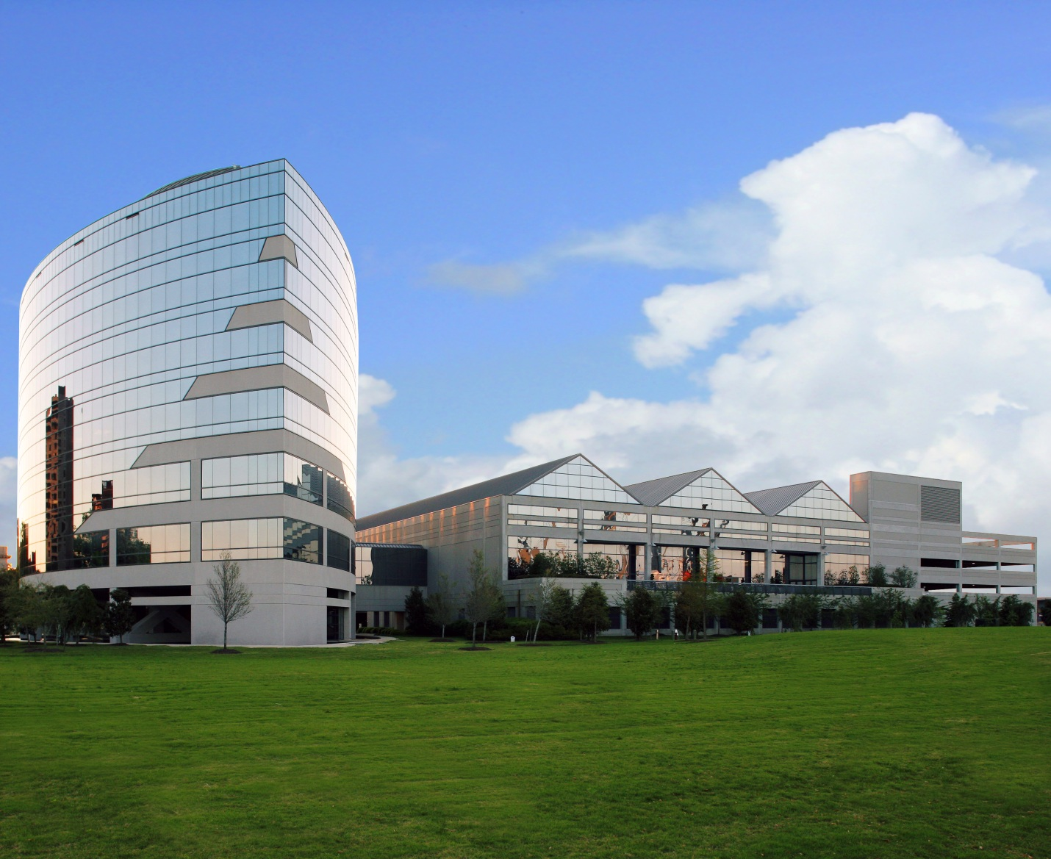
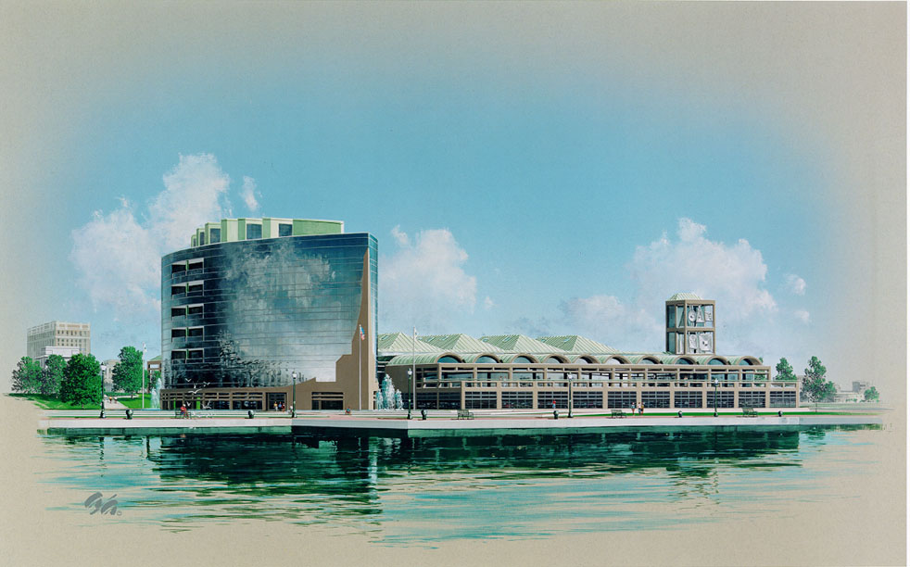
VIRGINIA ADVANCED SHIPBUILDING & CARRIER INTEGRATION CENTER
NEWPORT NEWS, VA
John Boyle
Structural Option
Thesis Advisor – Dr. Behr
Source: Clark-Nexsen
Source: Clark-Nexsen

Slide 2
ACKNOWLEDGEMENTS
I would like to thank the following individuals for their support on this project
Professor M. Kevin Parfitt
Professor Robert Holland
Dr. Behr
Kurt J. Clemente
I would also like to thank my parents, John and Diana for their relentless support throughout this semester

Slide 3
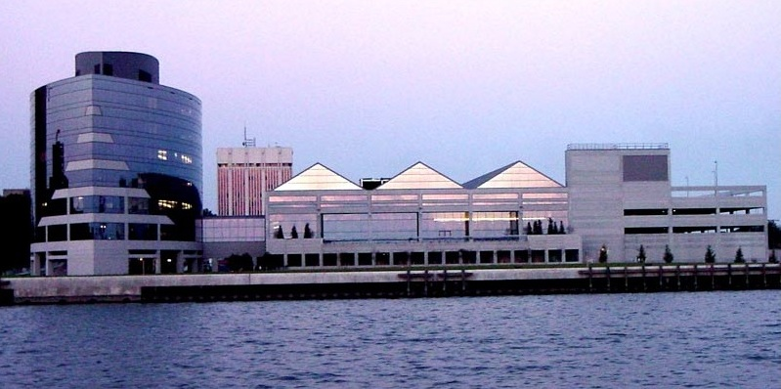
Introduction
Building Statistics
Architecture
Existing Structural System
Problem Statement
Proposed Solution
Architectural Breadth: Column Layout Redesign
Slab Redesign
Loads
Column Redesign
Lateral System Redesign
CM Breadth: Cost Analysis
Flood Analysis
Building Statistics
Project Team
Building Occupancy Name: Northrop Grunman Newport News
Occupancy Type: Office / Research / Shipbuilding Facility
Size: 241,000 sf
Number of Stories: 8
Date of Construction: December 1999-February 2002
Actual cost: $58 million
Project Delivery: Design-Bid-Build
Clark-Nexsen Architecture & Engineering
Source: Clark-Nexsen

Slide 4
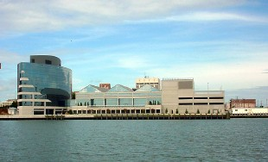
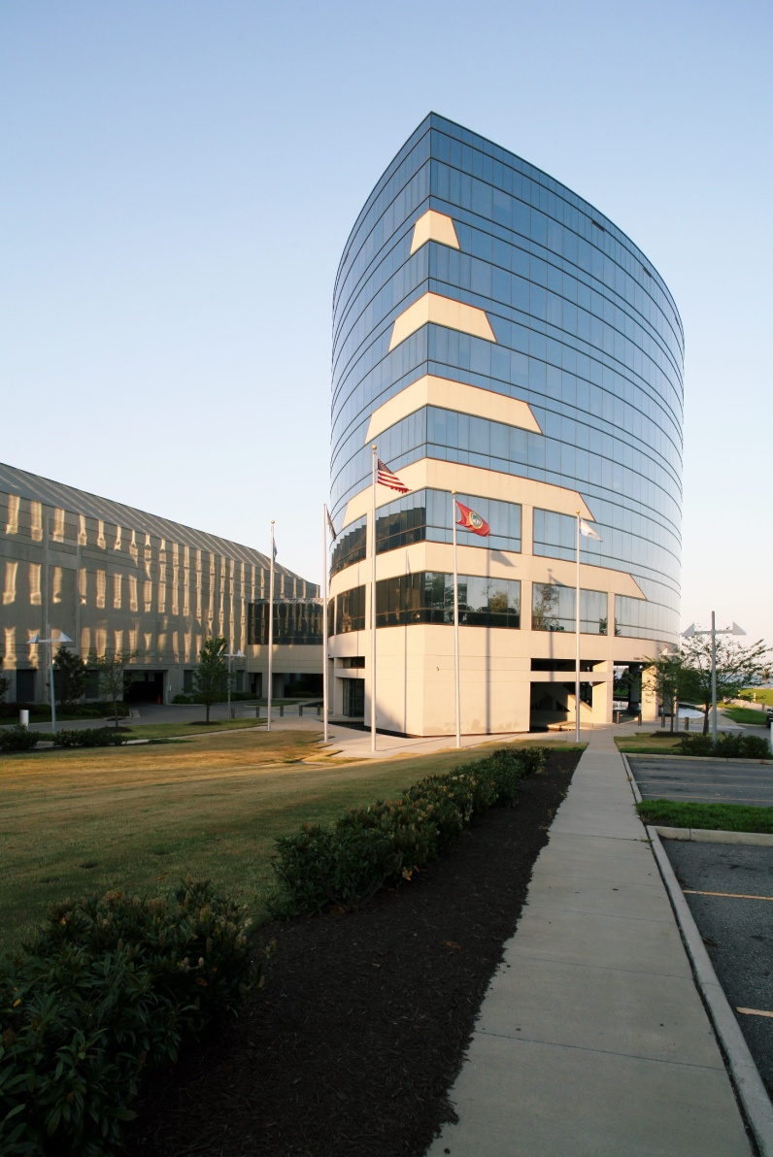
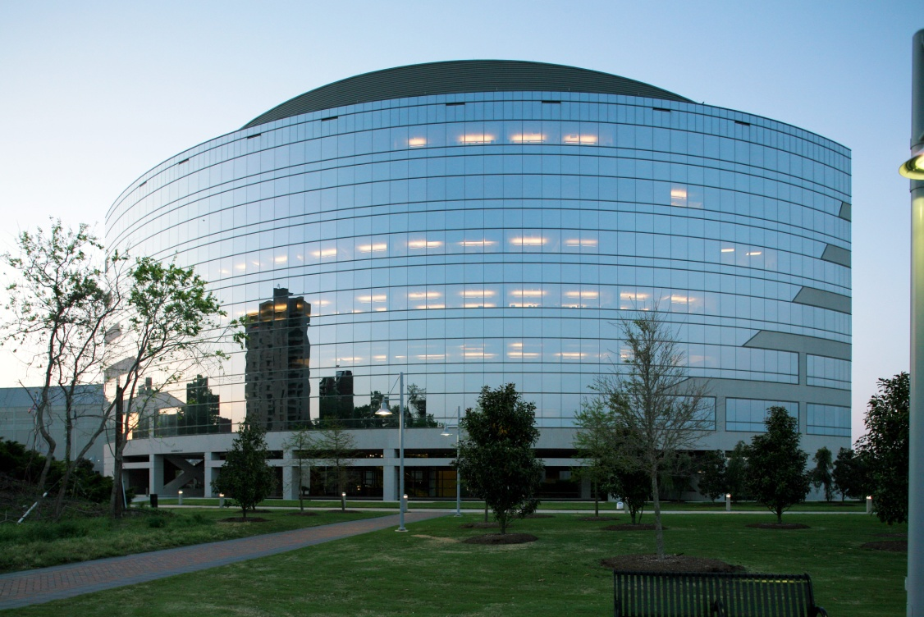
Introduction
Building Statistics
Architecture
Existing Structural System
Problem Statement
Proposed Solution
Architectural Breadth: Column Layout Redesign
Slab Redesign
Loads
Column Redesign
Lateral System Redesign
CM Breadth: Cost Analysis
Flood Analysis
Architecture
Achieves light, open feel
Uses steel wide-flange members
Enclosed in reflective curtain wall
Curve shape
Gives appearance of a tall, glass ship looking over the James River
Concrete “figurehead”
Source: Clark-Nexsen

Slide 5
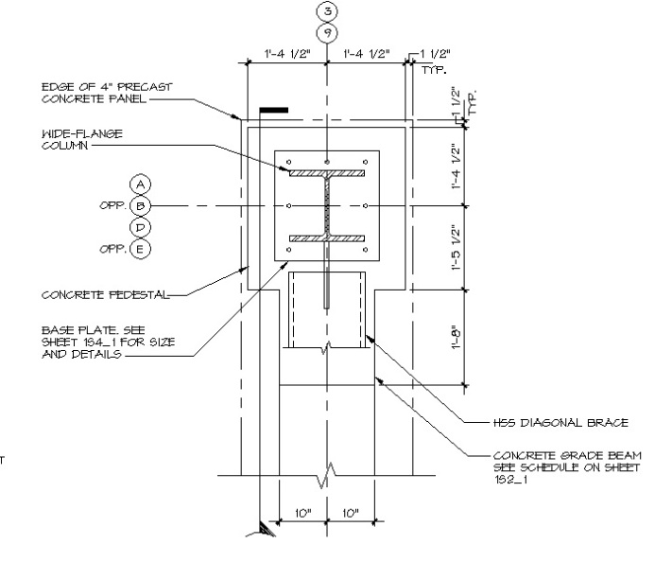
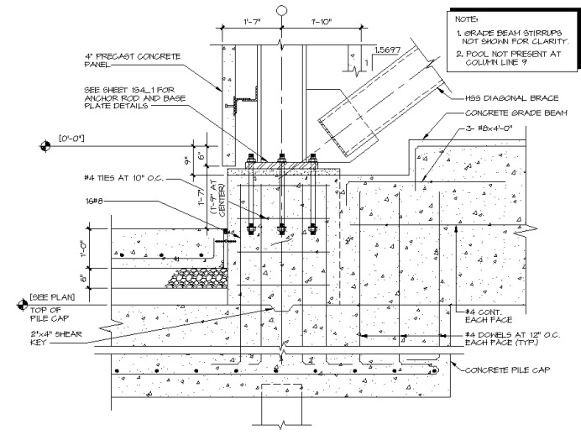
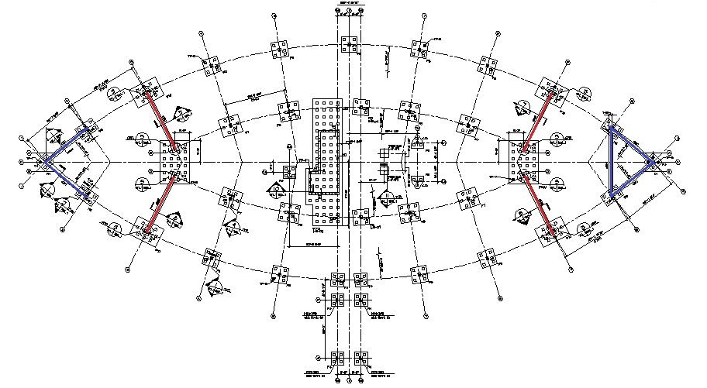
Introduction
Existing Structural System
Foundation
Gravity
Lateral
Problem Statement
Proposed Solution
Architectural Breadth: Column Layout Redesign
Slab Redesign
Loads
Column Redesign
Lateral System Redesign
CM Breadth: Cost Analysis
Flood Analysis
Existing Structural System
FOUNDATION
CONC. PEDESTAL PLAN
Wide-flange steel column on a concrete pedestal
Placed around perimeter of the building
Soil Condition: Unstable soil
Grade beams: 20” & 22”
Resist lateral column base movement
Distribute weight of the building over soil
CONC. PEDESTAL SECTION
Source: Clark-Nexsen
Source: Clark-Nexsen
Source: Clark-Nexsen
Notes:
Unstable Soil due to waterfront location of building
Grade beams important due to unstable soil conditions
22” – Blue
20” - Red

Slide 6
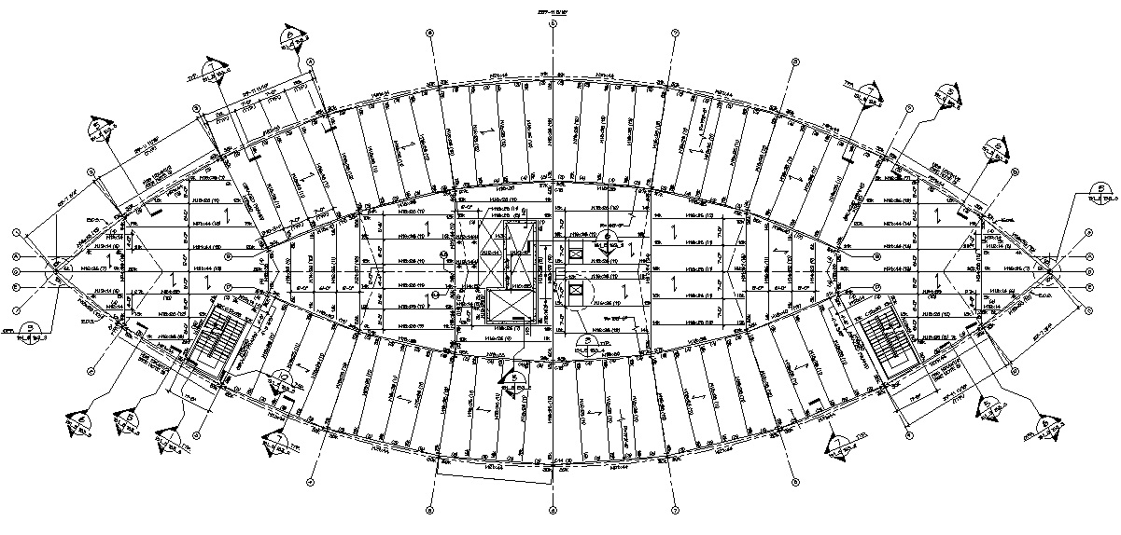
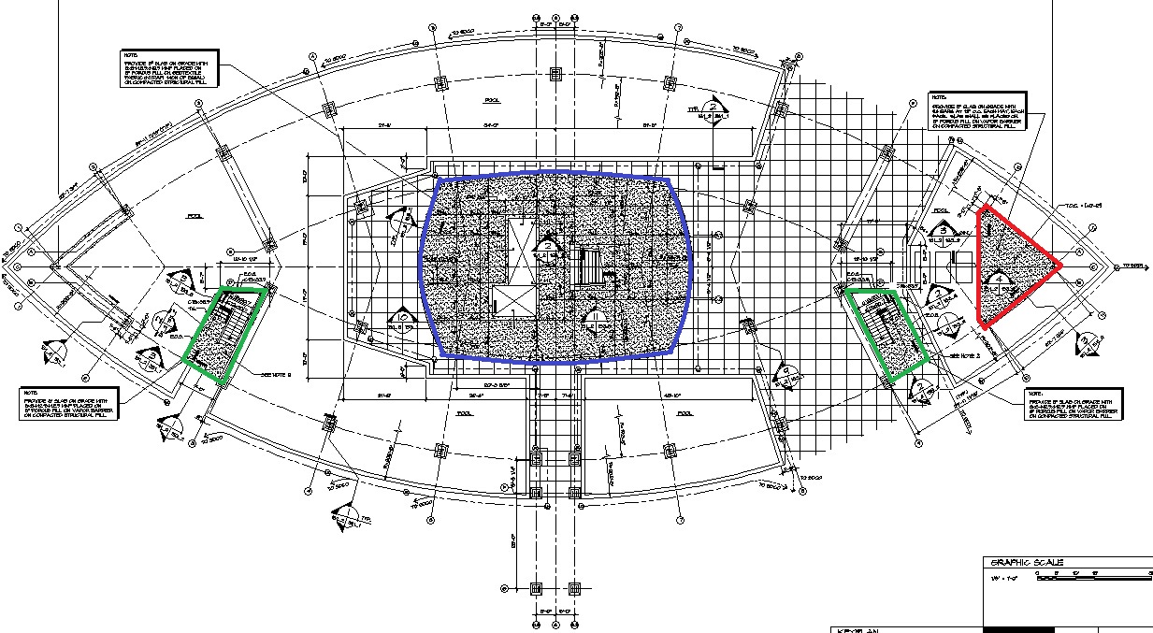
Introduction
Existing Structural System
Foundation
Gravity
Lateral
Problem Statement
Proposed Solution
Architectural Breadth: Column Layout Redesign
Slab Redesign
Loads
Column Redesign
Lateral System Redesign
CM Breadth: Cost Analysis
Flood Analysis
Existing Structural system
GRAVITY
Floors 2-7
Structural Floorplan
FLOOR
4.5” total thickness composite steel deck and slab
Lightweight concrete placed 2” deep, .038” thick galvanized steel deck
Yield Strength: 33 ksi
BEAMS / COLUMNS
Steel wide-wide flange members
W12x14 – W18x40 used for beams
W8, W10, W12, W14 used for columns
1st Floor
5” slab on grade w/ 6x6 W2.9xW2.9 WWF (blue)
8” slab on grade- #4 bars @ 12” o.c. (red)
6” slab on grade w/ 6x6 W2.9xW2.9 WWF (green)
Source: Clark-Nexsen
First Floor
Structural Floorplan
Source: Clark-Nexsen

Slide 7
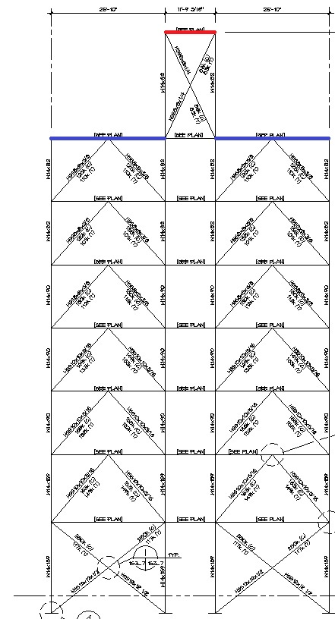
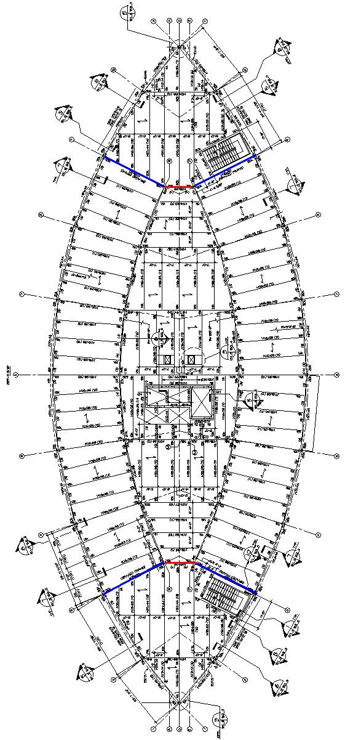
Introduction
Existing Structural System
Foundation
Gravity
Lateral
Problem Statement
Proposed Solution
Architectural Breadth: Column Layout Redesign
Slab Redesign
Loads
Column Redesign
Lateral System Redesign
CM Breadth: Cost Analysis
Flood Analysis
Existing Structural System
K-Braced Frame Location
K-Braced Frame Section
LATERAL
K-Braced Frame
Wide-flange members used for vertical members
W14x82 – W14x90 – W14x159
HSS members used for cross-bracing
X-Bracing used in 3 bays
Penthouse resists largest wind force
Bays on bottom level have added weight of floors above
X-bracing allows one member to be in tension and one to be in compression
Caters well to the shape of the building
Allows lateral loads to be distributed throughout the unique shape of the building
Source: Clark-Nexsen
Source: Clark-Nexsen
Notes:
W14x82 at top
W14x90 in middle
W14x159 bottom

Slide 8
Introduction
Existing Structural System
Problem Statement
Proposed Solution
Architectural Breadth: Column Layout Redesign
Slab Redesign
Loads
Column Redesign
Lateral System Redesign
CM Breadth: Cost Analysis
Flood Analysis
Problem Statement
Curved shape leads to confusing column layouts
Current column layout leads to confusing beam and joist layouts
Creates great differences in floor depth

Slide 9
Introduction
Existing Structural System
Problem Statement
Proposed Solution
Architectural Breadth: Column Layout Redesign
Slab Redesign
Loads
Column Redesign
Lateral System Redesign
CM Breadth: Cost Analysis
Flood Analysis
Problem Solution
Investigate new column layouts
Redesign structural system using reinforced concrete
Composite Steel Deck / Wide flange steel beams
=> Two-way flat slabs
Wide flange steel columns
=> Reinforced concrete columns
K-Braced lateral resisting frame
=> Shear walls
Reduces floor thickness which will allow building to keep a light, open feel and may reduce cost

Slide 10
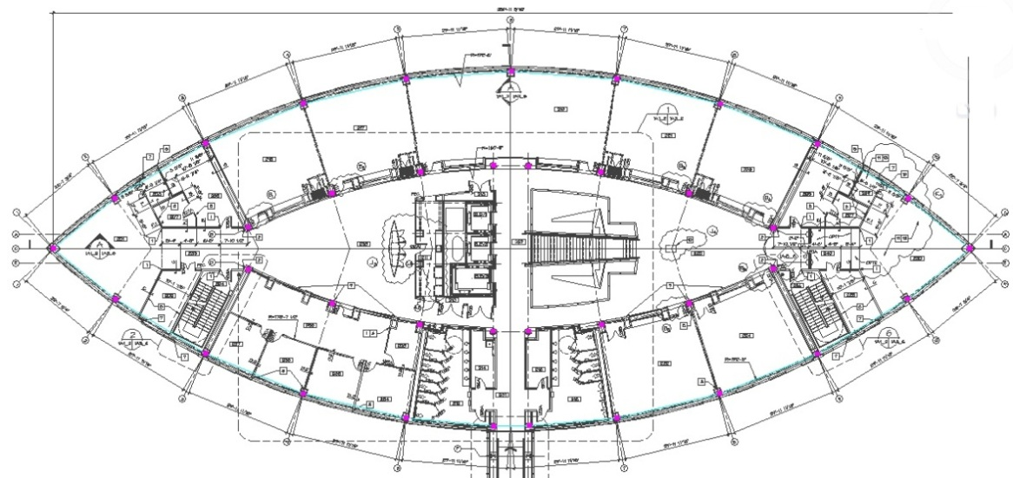
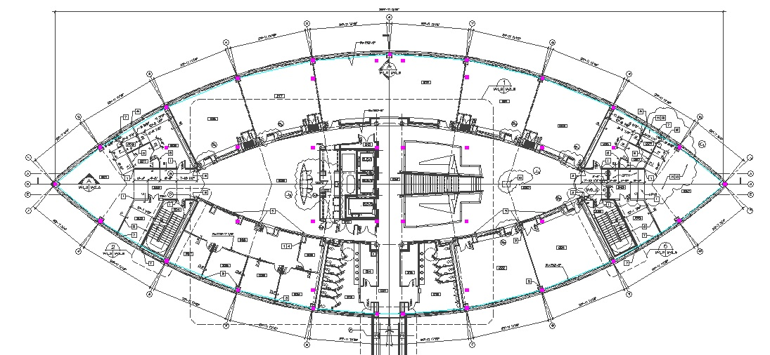
Introduction
Existing Structural System
Problem Statement
Proposed Solution
Architectural Breadth: Column Layout Redesign
Slab Redesign
Loads
Column Redesign
Lateral System Redesign
CM Breadth: Cost Analysis
Flood Analysis
Architectural Breadth:
Column Layout Redesign
Original column layout:
Contains irregularly shaped bays
Crafted to shape of building
Redesign
Created grid using existing perimeter columns
Created moderately sized, rectangular bays
Will make designing column strips and drop panels easier
Smallest Bay: 24’-11” x 2’-3”
Largest Bay: 29’-11” x 33’-10”
Columns are placed with little-to-no interference with the current floor plan
Current Column Layout
Source: Clark-Nexsen
Redesigned Column Layout
Source: Clark-Nexsen

Slide 11
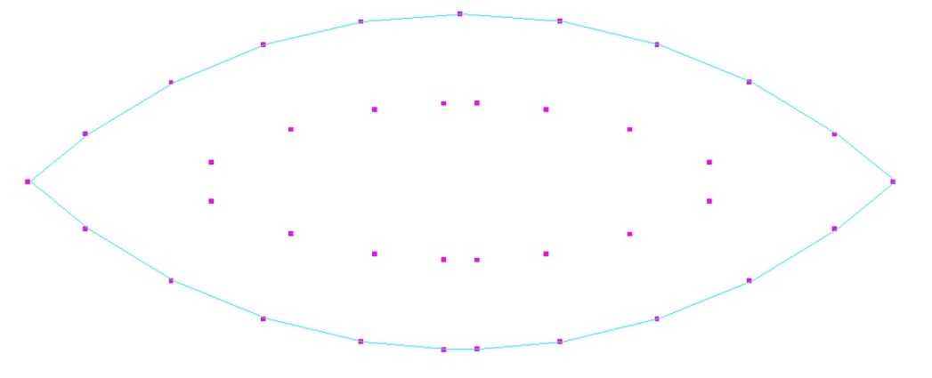
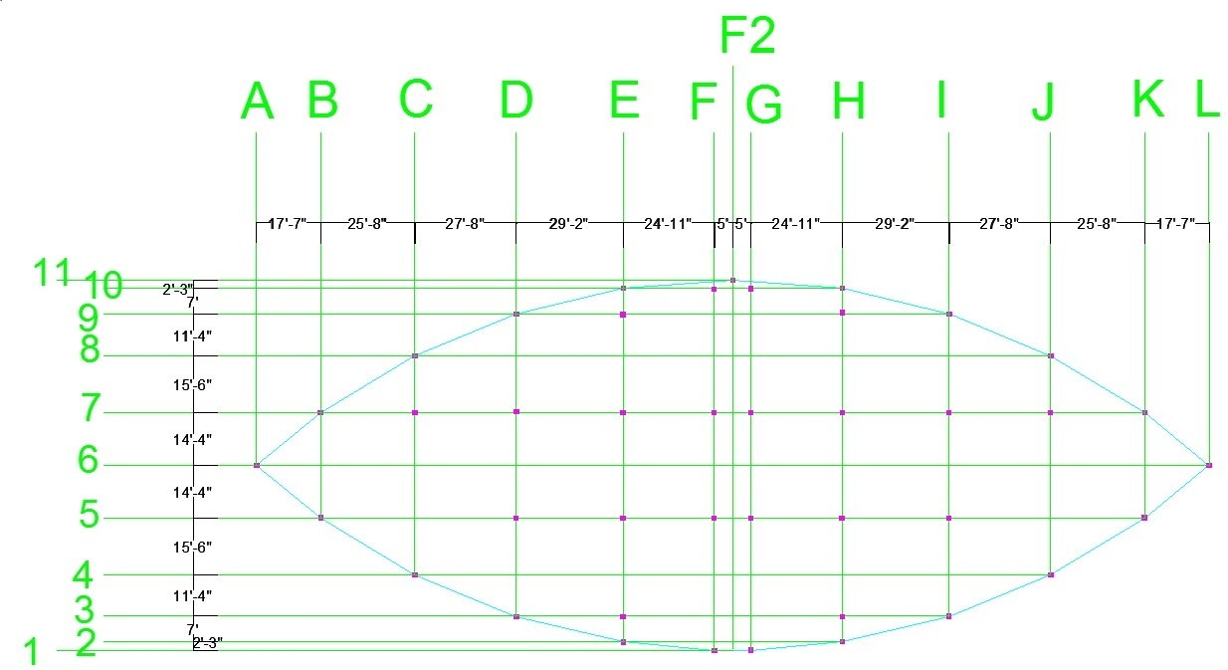
Introduction
Existing Structural System
Problem Statement
Proposed Solution
Architectural Breadth: Column Layout Redesign
Slab Redesign
Loads
Column Redesign
Lateral System Redesign
CM Breadth: Cost Analysis
Flood Analysis
Architectural Breadth:
Column Layout Redesign
Original column layout:
Contains irregularly shaped bays
Crafted to shape of building
Redesign
Created grid using existing perimeter columns
Created moderately sized, rectangular bays
Will make designing column strips and drop panels easier
Smallest Bay: 24’-11” x 2’-3”
Largest Bay: 29’-11” x 33’-10”
Columns are placed with little-to-no interference with the current floor plan
Current Column Layout
Redesigned Column Layout

Slide 12
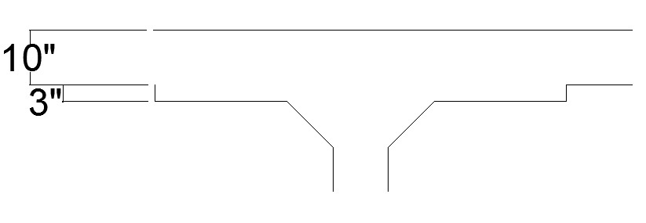
Introduction
Existing Structural System
Problem Statement
Proposed Solution
Architectural Breadth: Column Layout Redesign
Slab Redesign
Results
Architectural Impact
Loads
Column Redesign
Lateral System Redesign
CM Breadth: Cost Analysis
Flood Analysis
Slab Redesign
Original floor system
Composite steel deck
Wide-flange steel beams
Floor thickness: 22.5”
Redesign
Two-way flat slab: 4,000 psi concrete
Advantages
Easy formwork
Simple bar placements
Minimize floor-to-floor heights
SLAB THICKNESS FLOORS 1-7
SLAB THICKNESS PENTHOUSE
Results
12” thickness w/ 3” drop panels
Penthouse:
10” thickness w/ 3” drop panels
Nearly 8”/floor reduction

Slide 13
Introduction
Existing Structural System
Problem Statement
Proposed Solution
Architectural Breadth: Column Layout Redesign
Slab Redesign
Results
Architectural Impact
Loads
Column Redesign
Lateral System Redesign
CM Breadth: Cost Analysis
Flood Analysis
Slab Redesign
Architectural Impact
8” reduction in floor thickness
Reduces total floor height by nearly 5 feet
FLOOR | HEIGHT (CURRENT BUILDING) | HEIGHT (REDESIGN)
1st | 0’-0” | 0’-0”
2nd | 17’-6” | 17’-6”
3rd | 32’-10” | 32’-2”
4th | 47’-2” | 45’-10”
5th | 61’-6” | 59’-6”
6th | 75’-10” | 73’-2”
7th | 90’-2” | 86’-10”
Penthouse | 104’-6” | 99’-8”
Roof | 126’-3” | 122’-1”

Slide 14
Introduction
Existing Structural System
Problem Statement
Proposed Solution
Architectural Breadth: Column Layout Redesign
Slab Redesign
Loads
Gravity
Wind
Column Redesign
Lateral System Redesign
CM Breadth: Cost Analysis
Flood Analysis
Loads
Live loads
Dead loads
GRAVITY
OCCUPANCY | DESIGN LOAD (psf) | THESIS LOAD (psf)
Penthouse Roof | 20 | 20
Low Roof | 80 | 60
Penthouse Floor | 125 | 125
Offices | 80 | 50
Conference Rooms | 100 | 100
Corridors | 100 | 80
Stairs | 100 | 100
Toilets | 75 | 75
Source: Clark-Nexsen
LOAD TYPE | LOAD
Normal Weight Concrete | 150 pcf
Lightweight Concrete | 120pcf
MEP | 10psf
Partitions | 20psf
Finishes | 10psf
Curtain Wall | 15psf
Source: Clark-Nexsen

Slide 15
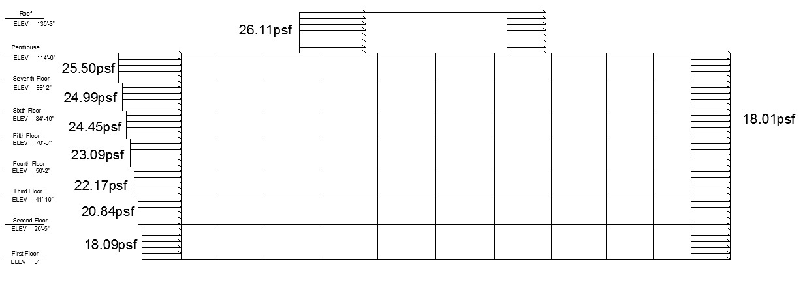
Wind Forces
Introduction
Existing Structural System
Problem Statement
Proposed Solution
Architectural Breadth: Column Layout Redesign
Slab Redesign
Loads
Gravity
Wind
Column Redesign
Lateral System Redesign
CM Breadth: Cost Analysis
Flood Analysis
Loads
 | Force (k) | Shear (k) | Moment (ft-k)
Ground | 0 | 179 | 0
First | 92 | 175 | 1603
Second | 87 | 177 | 2863
Third | 87 | 182 | 4123
Fourth | 90 | 190 | 5533
Fifth | 92 | 219 | 6984
Sixth | 97 | 191 | 8783
Penthouse | 121 | 70 | 12783
Roof | 70 | 0 | 8873
Location: Newport News, VA
Exposure: D (Building @ Shoreline)
Occupancy: III
Basic Wind Speed (V): 90 mph
WIND
Wind Loads
 | Height | Kz | qz | P | Height Difference | F
First | 9 | 0.943 | 16.62 | 18.09 | 0 | 0.00
Second | 26.5 | 1.137 | 20.05 | 20.84 | 17.5 | 91.60
Third | 41.83 | 1.231 | 21.70 | 22.17 | 15.33 | 87.19
Fourth | 56.16 | 1.296 | 22.85 | 23.09 | 14.33 | 87.43
Fifth | 70.5 | 1.348 | 23.77 | 23.83 | 14.34 | 89.97
Sixth | 84.83 | 1.393 | 24.54 | 24.45 | 14.33 | 92.11
Seventh | 99.16 | 1.431 | 25.22 | 24.99 | 14.33 | 97.42
Penthouse | 114.5 | 1.467 | 25.86 | 25.50 | 15.34 | 121.17
Roof | 135.21 | 1.510 | 26.62 | 26.11 | 20.71 | 70.30
Wind Diagram

Slide 16
Introduction
Existing Structural System
Problem Statement
Proposed Solution
Architectural Breadth: Column Layout Redesign
Slab Redesign
Loads
Column Redesign
Design Criteria
RAM Model
Results / Architectural Impact
Checks
Lateral System Redesign
CM Breadth: Cost Analysis
Flood Analysis
Column Redesign
Original column design
Steel wide-flange members
Redesign
Reinforced concrete columns w/ steel rebar
Columns kept as small as possible to retain the light, open feel of the current design
DESIGN CRITERIA

Slide 17
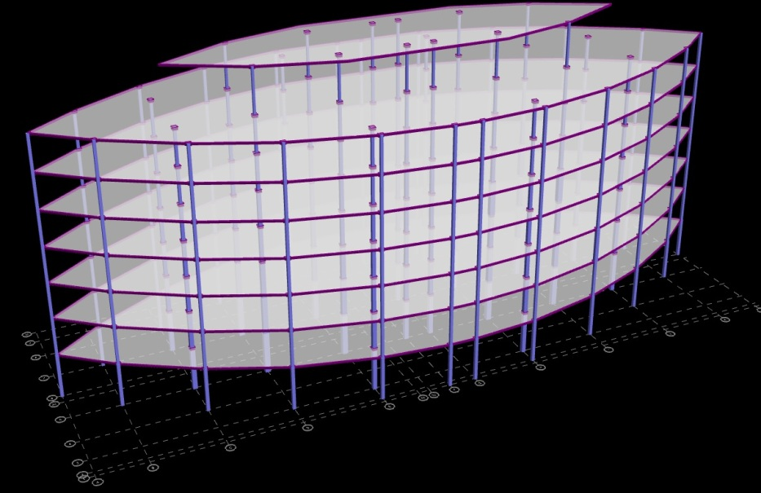
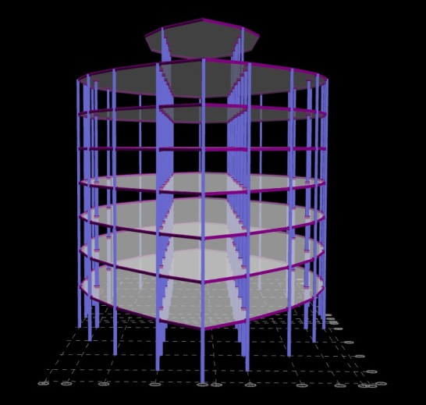
Introduction
Existing Structural System
Problem Statement
Proposed Solution
Architectural Breadth: Column Layout Redesign
Slab Redesign
Loads
Column Redesign
Design Criteria
RAM Model
Results / Architectural Impact
Checks
Lateral System Redesign
CM Breadth: Cost Analysis
Flood Analysis
Column Redesign
DL: 80 psf
LL carefully placed with floor plan
Bar configurations:
# of bars range from 8-16
RAM Model
RAM MODEL
Front View

Slide 18
Introduction
Existing Structural System
Problem Statement
Proposed Solution
Architectural Breadth: Column Layout Redesign
Slab Redesign
Loads
Column Redesign
Design Criteria
RAM Model
Results / Architectural Impact
Checks
Lateral System Redesign
CM Breadth: Cost Analysis
Flood Analysis
Column Redesign
RESULTS
10”x10” in penthouse
24x24” in first floor
ARCHITECTURAL IMPACT
Columns larger than anticipated
Larger columns located in more open, spacious areas

Slide 19
Introduction
Existing Structural System
Problem Statement
Proposed Solution
Architectural Breadth: Column Layout Redesign
Slab Redesign
Loads
Column Redesign
Design Criteria
RAM Model
Results / Architectural Impact
Checks
Lateral System Redesign
CM Breadth: Cost Analysis
Flood Analysis
Column Redesign
Checks
Column D-7, Level 3
At = 847 ft²
DL = 180 psf
LL = 80 psf
W_{u} = 1.2(180) + 1.6(80) = 344 psf
P_{u 3rd floor} = $\frac{344(8437)}{1000}$ = 291.37 k
P_{u above floors} = 1268.25 k
P_{u} = 291.37 + 1268.25 = 1559.2 k
M_{uT} = 36.12 ft-k
M_{uB} = -22.08 ft-k
H = 13.33 ft
F_{y} = 60 ksi
F’_{c} = 4 ksi
14 #10 bars
ΦP_{n} = .8Φ[.85f’_{c}(A_{g} – A_{st}) + fy(A_{st})]
Φ(1559.2) = .8Φ[.85(4)(20(20) – 14(1.27)) + 60(14)(14)(1.27)]
1559.2 < 1893.1 => ok

Slide 20
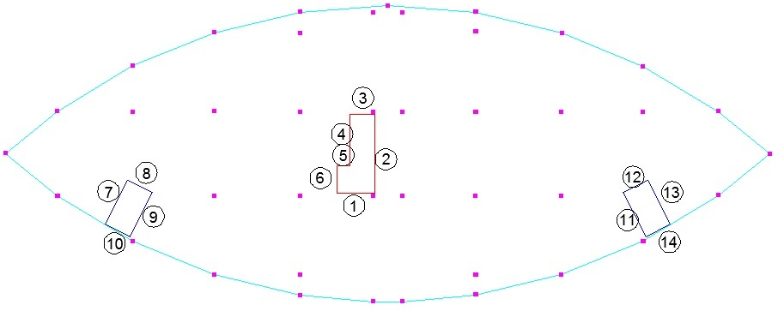
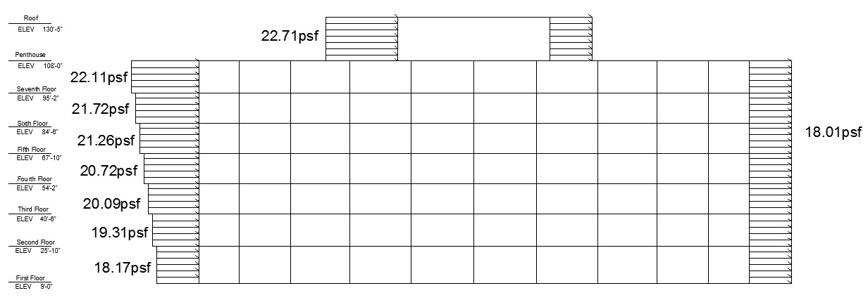
Introduction
Existing Structural System
Problem Statement
Proposed Solution
Architectural Breadth: Column Layout Redesign
Slab Redesign
Loads
Column Redesign
Lateral System Redesign
Design Criteria
Results
CM Breadth: Cost Analysis
Flood Analysis
Lateral System Redesign
New Wind Forces
Original Lateral System
K-Braced Frame with steel wide-flange and HSS members
Redesign
Reinforced concrete shear walls
Existing concrete walls used
Stair wells (blue)
Elevator shaft / mechanical space (red)
 | Force (k) | Shear (k) | Moment (ft-k)
First | 0 | 149.1 | 0
Second | 76.6 | 145.0 | 1289
Third | 72.5 | 147.1 | 2284
Fourth | 72.5 | 151.0 | 3274
Fifth | 74.6 | 151.8 | 4389
Sixth | 76.4 | 178.6 | 5536
Seventh | 75.5 | 169.3 | 6504
Penthouse | 103.1 | 66.2 | 10207
Roof | 66.2 | 0.0 | 8036
New Wind Diagram

Slide 21
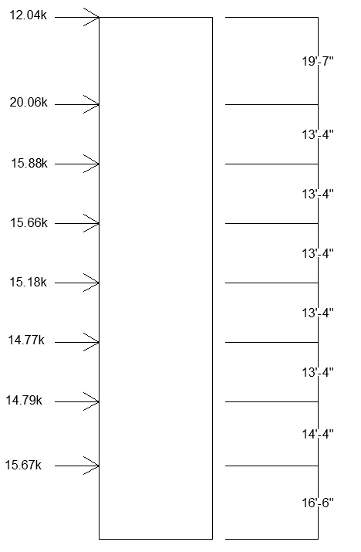
Introduction
Existing Structural System
Problem Statement
Proposed Solution
Architectural Breadth: Column Layout Redesign
Slab Redesign
Loads
Column Redesign
Lateral System Redesign
Design Criteria
Results
CM Breadth: Cost Analysis
Flood Analysis
Lateral System Redesign
Results
Both stairwell and elevator / mechanical space walls needed
10” walls
J-Values
Floor | ΣKX² | ΣKY² | J
1st | 336,396 | 110,153 | 446,549
2nd | 486,015 | 160,457 | 646,472
3rd-Penthouse | 585,073 | 197,580 | 782,653
Shear Wall Design
Wall | Reinforcement (bars) | Spacing (inches)
2 | #7 | 16
4 | #6 | 18
6 | #2 | 18
7 | #5 | 16
8 | #3 | 18
9 | #5 | 16
10 | #3 | 18
11 | #5 | 16
12 | #3 | 18
13 | #5 | 16
14 | #3 | 18

Slide 22
Introduction
Existing Structural System
Problem Statement
Proposed Solution
Architectural Breadth: Column Layout Redesign
Slab Redesign
Loads
Column Redesign
Lateral System Redesign
CM Breadth: Cost Analysis
Flood Analysis
Construction Management Breadth:
Cost Analysis
Original Steel Design: $1,411,217
Concrete Redesign: $1,285, 191
Slab: $831,960
Columns: $383,363
Shear Walls: $69,868

Slide 23
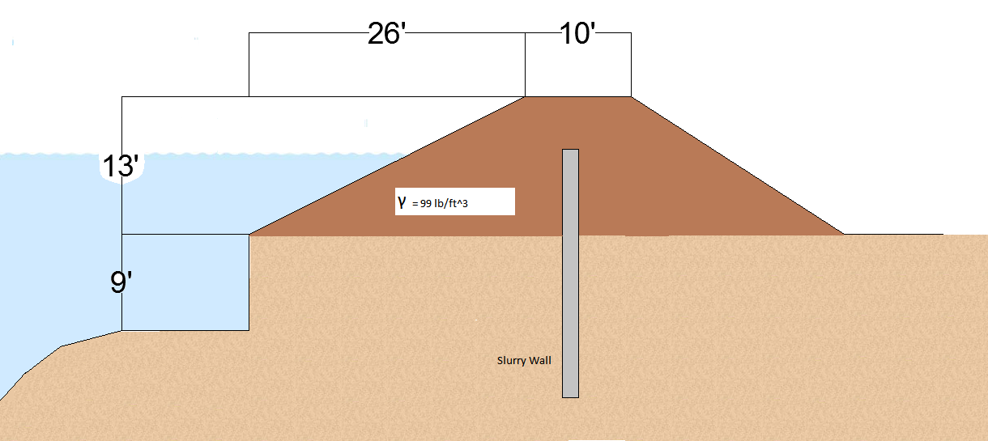
Introduction
Existing Structural System
Problem Statement
Proposed Solution
Architectural Breadth: Column Layout Redesign
Slab Redesign
Loads
Column Redesign
Lateral System Redesign
CM Breadth: Cost Analysis
Flood Analysis
Flood Analysis
Levee Design
Highest flood level of James River: 22 ft
VASCIC 9 ft above sea level
Levee Design
Soil: sand, dense and well graded
Aesthetically pleasing
Resists 811 lb/sf force acting on levee
Resists seepage
Slurry Wall: Soil-cement bentonite
High productivity
Verifiable continuity and depth
Excellent resistance to contaminated water
Ability to easily flex with ground movements
Greater trench stability possible
Resistant to erosion and burrowing animals

Slide 24
Thank You For Your Time

